Slide 1
US Salary Data : Classification
DAWIEANG Phudis

Slide 2
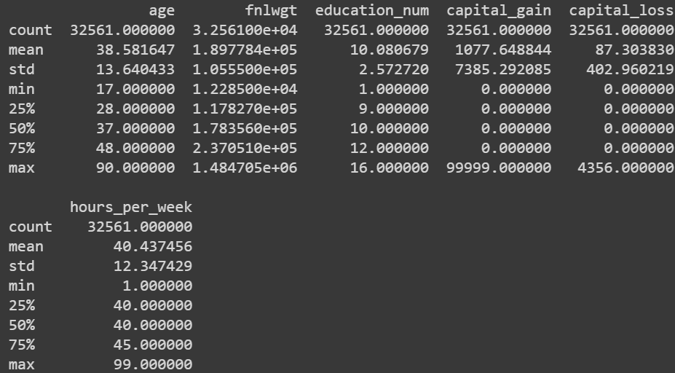
What is this data???
1994 Census Database
Binary Classification (>50K USD per year or <= 50K USD per year)
~32.6K training set
Including missing data
Contain both categorical data and continuous data

Slide 3
Flowchart
Preprocessing
Train Model
Prediction
One-hot encoding
Linear SVM
10-fold Cross Validation
Predict from test data
Accuracy = (correct)/(all)
Categorial Imputation
Import Data

Slide 4
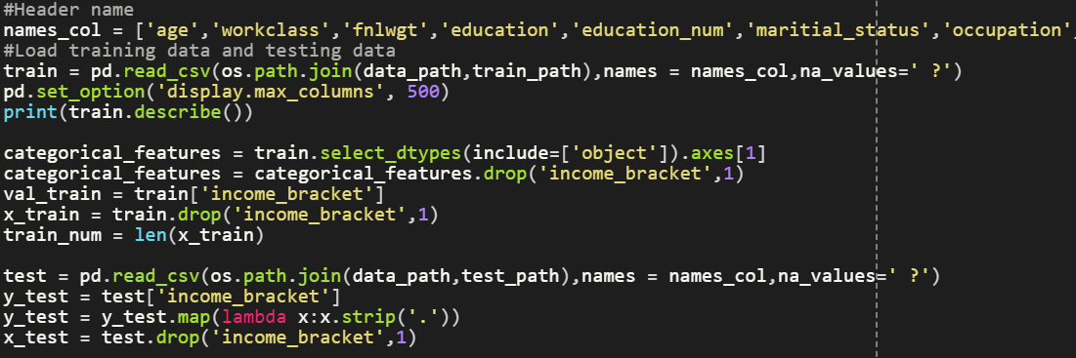
Import Data

Slide 5
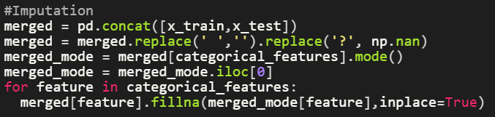
Categorial Imputation (Mode Imputation)
Replace missing values with mode of that features

Slide 6
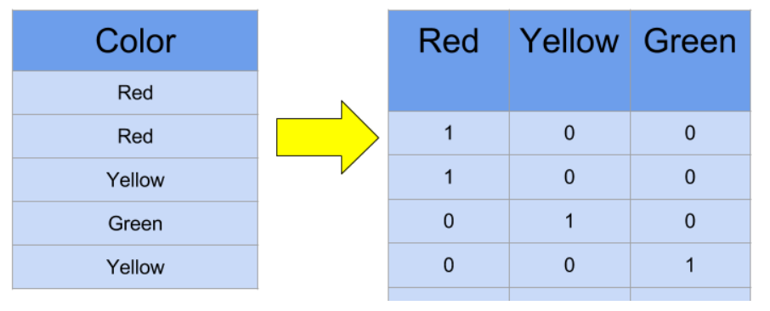
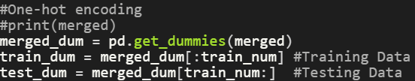
One-Hot Encoding

Slide 7
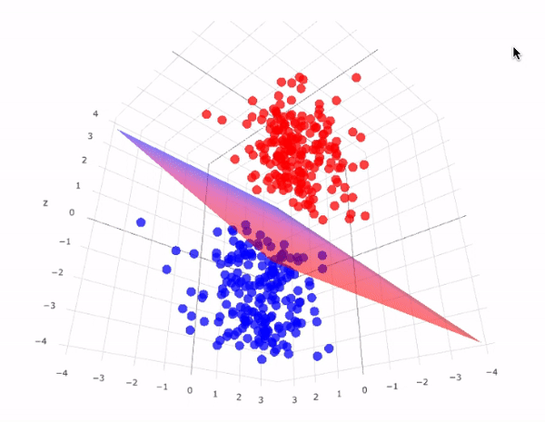
SVM

Slide 8
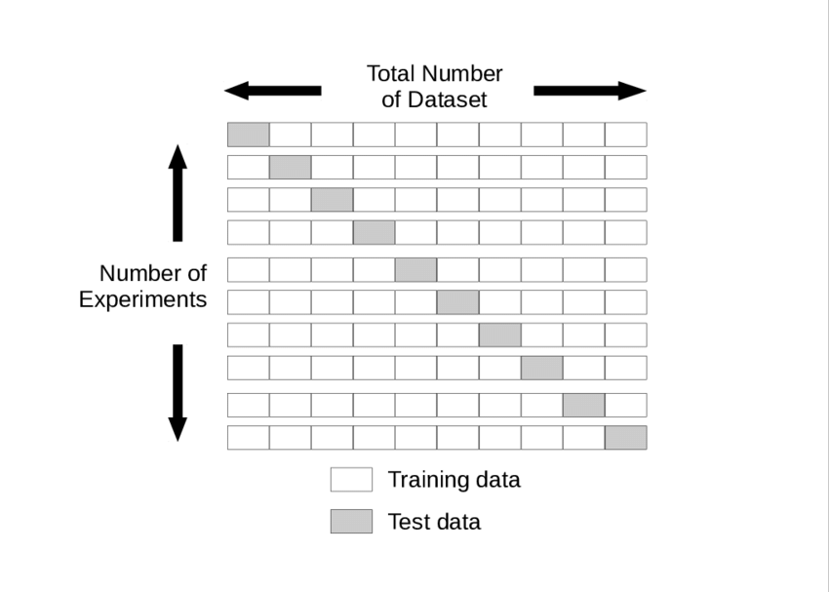
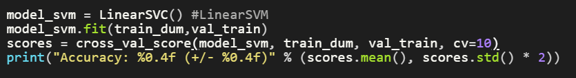
Cross Validation

Slide 9
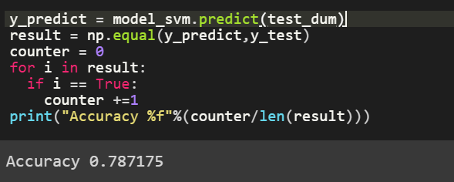
Prediction

